Slide 1
Introduction To Backend Developmant

Slide 2
TABLE OF CONTENTS
01
03
02
04
What is Backend Development
Intro to PHP
Tools and Technologies
Environment setup

Slide 3
01
What is Backend Development

Slide 4

What is Backend Development
Backend Development is the term for the behind-the-scenes activities that happen when you do anything on a website or web application. Backend Development is mostly referred to as the server-side of an application and everything that communicates between the database and the frontend (browser). You can also say that Backend Development the server-side of development that focuses primarily on how the site works.

Slide 5
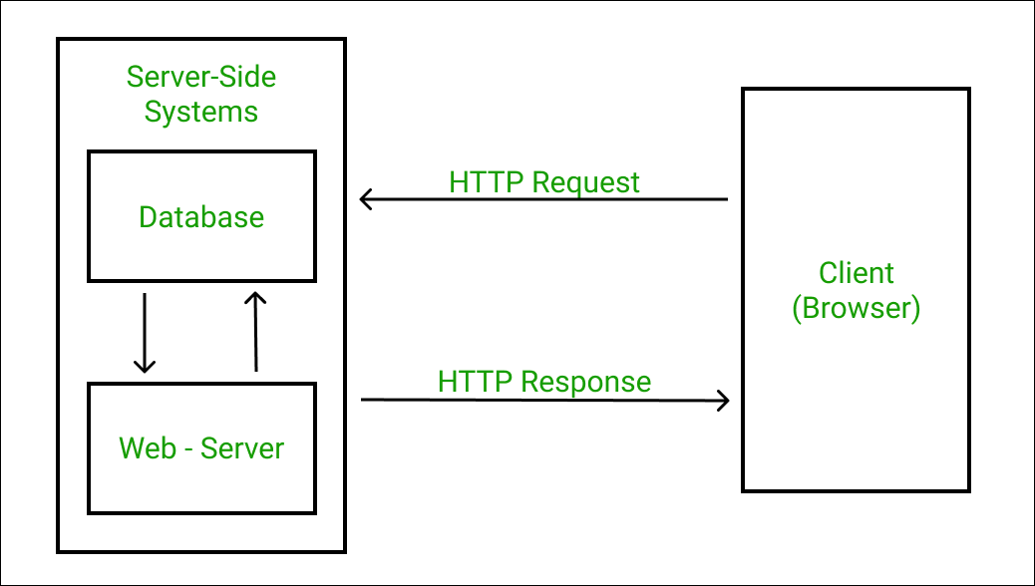

Slide 6
02
Backend Development: Tools and Technologies

Slide 7
Tools and Technologies
Server ( Apache ) : A computer that listens for incoming requests from the clients.
Communication Protocol ( HTTP ) : It comprises of the formal description of rules and formats of a digital messages.
Databases ( MYSQL ) : provide an interface to save data in a persistent way to memory.
Programming Language ( PHP )

Slide 8
03
Intro To PHP

Slide 9
Intro to PHP
PHP is a leading server-side scripting technology that was introduced by Rasmus Lerdorf in 1994.
This open-source backend technology is commonly used for websites. Around 79.1% of websites on the internet use PHP as server-side technology, according to a recent survey of W3Techs.
This general-purpose scripting language is easy to use and emend information in the databases.
The availability of several modern frameworks, massive community,
robust codebase, and easy deployment also adds tremendous value to this technology.

Slide 10
PHP Features
Open Source & Platform Independent
Security Against Target Attacks
Simplifies Programming
Cost-Effective

Slide 11
04
Environment Setup

Slide 12
Environment Setup
Manually install all the required packages (MySQL, PHP & Apache) and configure them.
Using all in one package (XAMPP & WAMPP). (recommended)

Slide 13
Environment Setup
Web Server − PHP will work with virtually all Web Server software
Database − PHP will work with virtually all database software
PHP Parser − In order to process PHP script instructions a parser must
be installed to generate HTML output that can be sent to
the Web Browser.

Slide 14
Environment Setup
Downloading XAMPP: You can download the XAMPP software from the official website with the latest windows version and latest PHP version.
Open the downloaded .exe file: After opening the downloaded file you will see a popup from windows, click yes and proceed further.
Click on ‘next’: You’ll see a welcome window of XAMPP like below, click next.

Slide 15
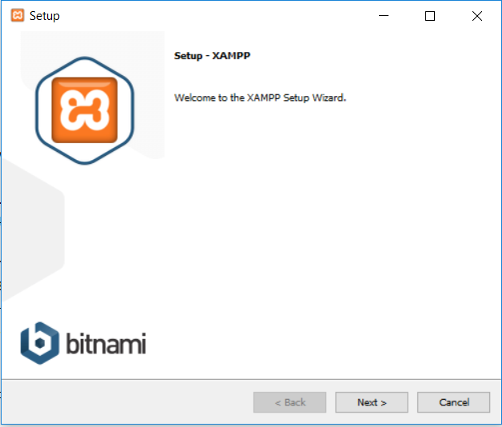

Slide 16
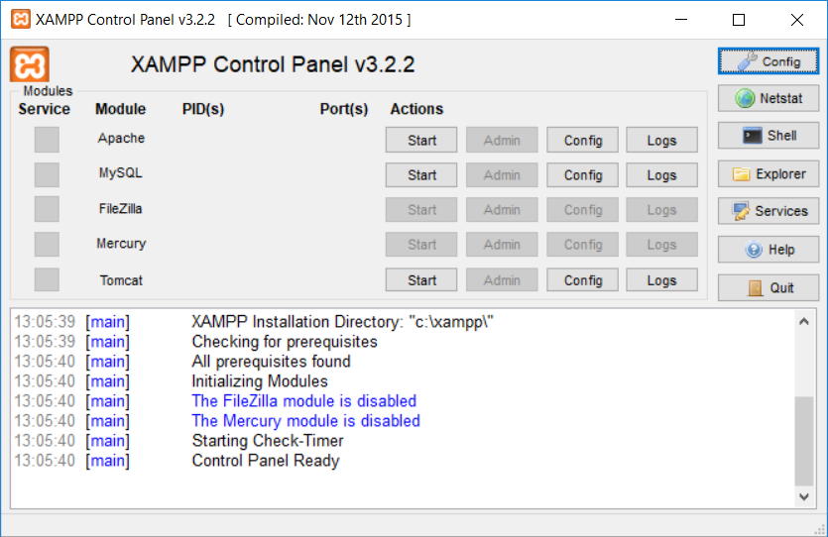

Slide 17

ASSIGNMENT
Code a simple Form has fields for username , his password , email .
___

Slide 18
THANKS!
Please, keep this slide for attribution.

